Slide 1
RedHat Academy

Slide 2
Link for registration
https://sso.redhat.com/auth/realms/redhat-external/protocol/openid-connect/auth?response_type=code&client_id=rha-webapp-prod&redirect_uri=https%3A%2F%2Frha.ole.redhat.com%2Frha%2Fauth_idp%2F%40%40redirect&state=NpCg8FEzLVRxCWpzpnJ3fBJfrXg3xq
RHD id and Email id must be same.
Please follow the highlighted instructions.

Slide 3
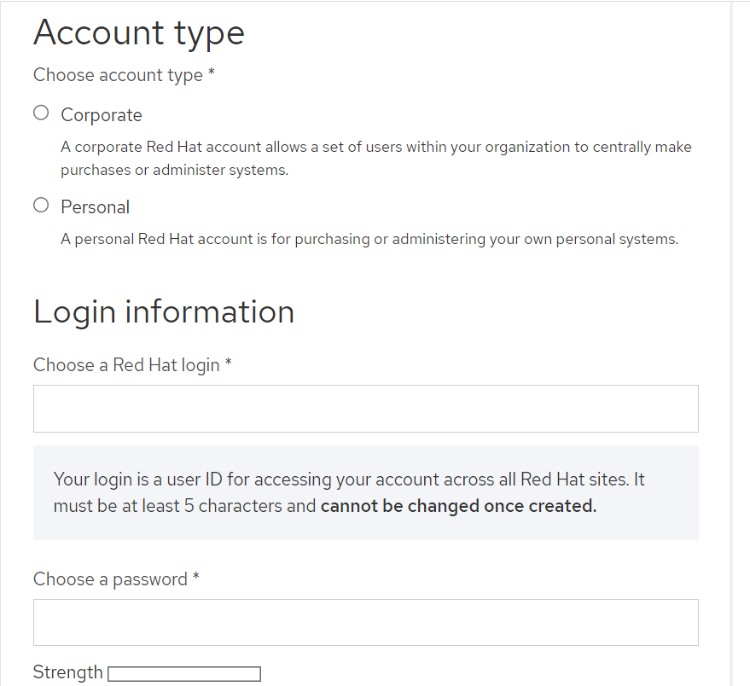



Registration
MUJ Outlook id

Slide 4
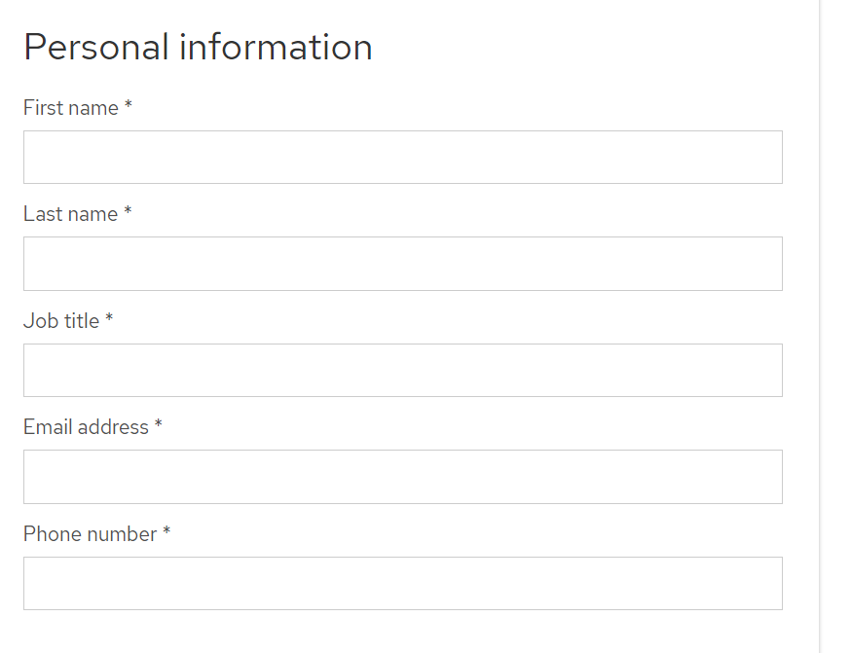



Student or Instructor
MUJ outlook id

Slide 5
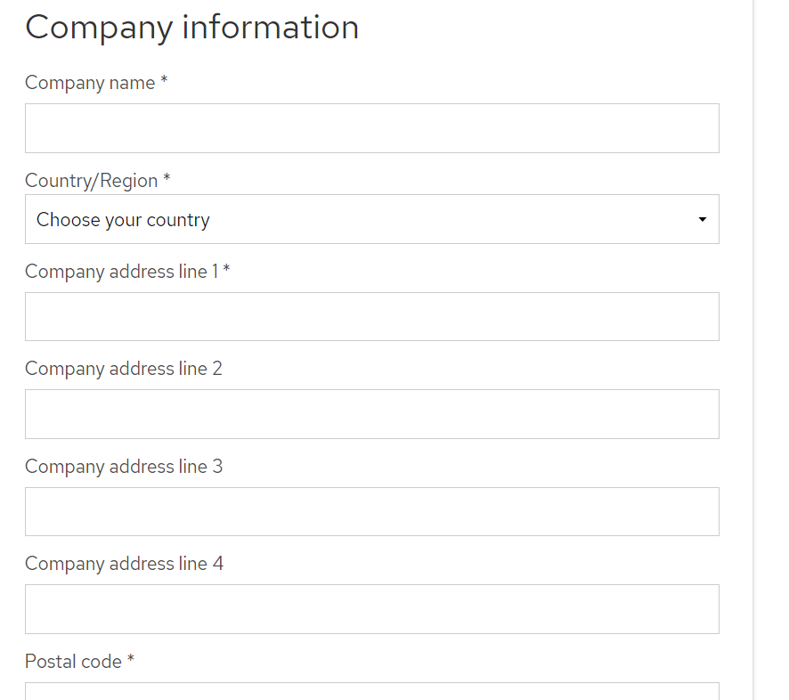

Manipal University Jaipur

